Slide 1
Intoxicated Face Identification
Artificial Intelligence
Ebenezer Isaac Veeraraju (522025)
Machine Learning Intern at
Rishabh Software - Atladara
Guided By :
Ksitij Tripati (MSU)
Gagan Dubey (RISE)
Notes:
1

Slide 2
Summary
This is a research based project focused on identification of intoxicated persons with the help of facial feature extraction algorithms implemented using neutral networks.
Develop
Previously Researched on by
IIT – Ropar in 2019
To develop a neural network that can extract facial features and distinguish between intoxicated and sober faces.
The objective of this research paper was to collect a dataset of persons in intoxicated state so that it can be further used in machine learning algorithms
Analyze
To calculate the accuracy of the machine learning model and try to improve it by using different algorithms
Credits : Dr. Abhinav Dhall, Vineet Mehta,
Katta Sai, Srinadhu Yadav, Devendra Pratap

Slide 3
Scope / Objective
Research on Artificial Intelligence
in the field of Healthcare
Detection
To detect possible intoxicated person using cameras installed at appropriate locations
Report
02
To report to designated authority leading to appropriate action

Slide 4
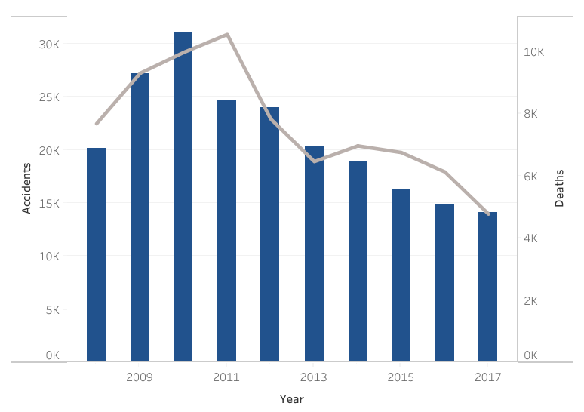
Business Problem
+76,446
People were killed between 2008 and 2017 in road accidents due to consumption of alcohol or drugs.
Accidents
Deaths

Slide 5
Current Solution
Detection of presence of Ethanol above specified limit
1
Presence of Ethanol in Breath
2
Presence of Ethanol in Blood
3
Presence of Ethanol in Urine
Notes:
5

Slide 6
Proposed Solution
Check probability of alcohol consumption using facial feature extraction by neural network and report to designated authority to take further action.
Fast
Economic
Instant
Portable
Prioritize
Tracking
Notes:
6

Slide 7
Process
Detection
Detect a face in a video stream
1
Analysis
Analyse facial features using neural network
2
3
Get results instantly from the machine learning model
Result
4
Action
Take appropriate action to prevent any untoward incident

Slide 8





Technologies

Slide 9
Modules
Accumulation
Modelling
Download Video Streams
Model a Neural Network
Extraction
Training
Face Detection and Extraction
Train Neural Network with data-set
Preparation
Analysis
Dataset Cleaning & Normalizing
Analyse Accuracy of Model

Slide 10
Screenshots
Main Project
Intoxicated Face Identification
Personal Organizer
Live Demo
This project’s objective was to revise and refresh all programming concepts taught in the training sessions taken during the internship before a main project was given.
This project is focused on identification of intoxicated persons with the help of facial feature extraction algorithms.
Mini Project

Slide 11

Personal Organizer
Work Completed
Communication
Coding
Gathering Requirements
1
4
Write the business login and add interactivity for easy user interface
Planning
Deployment
2
5
Deploy the Project for the end user
Requirement Engineering
Modeling
Documentation
Design the Project Model
3
6
Prepare Final Documentation of the Project

Slide 12


Slide 13
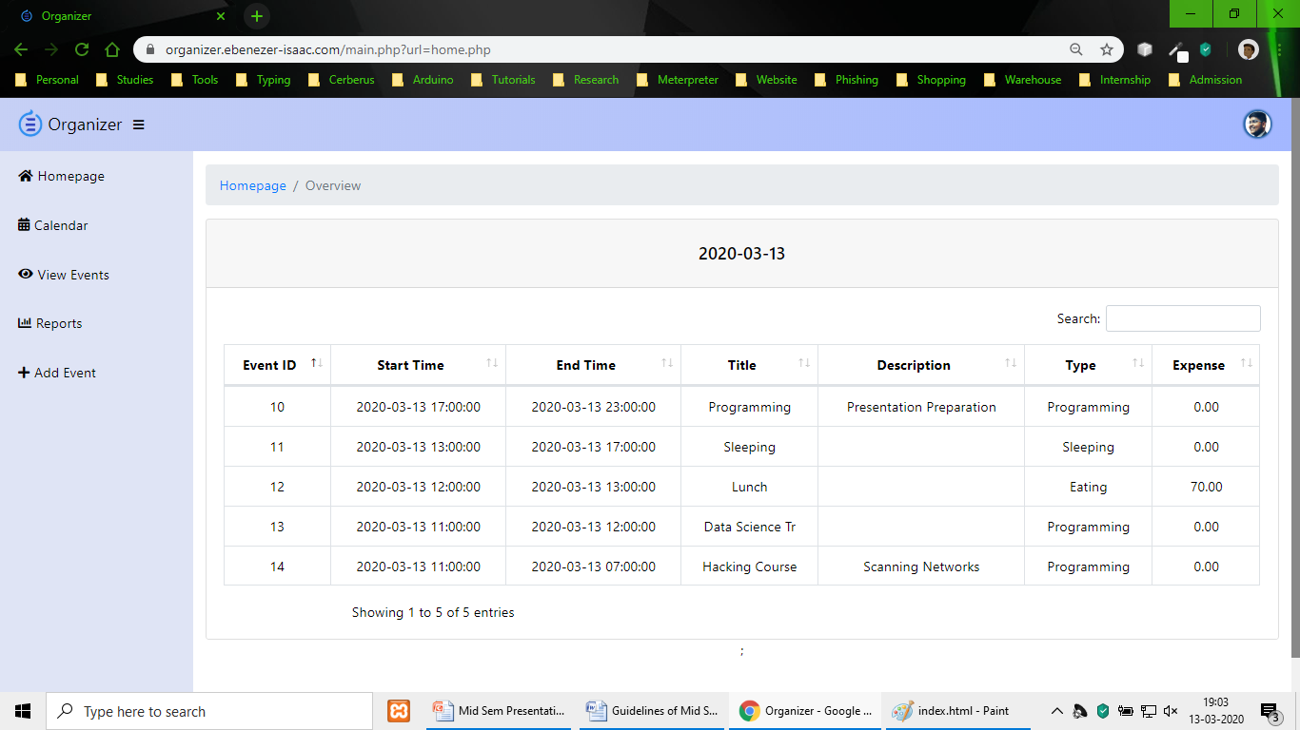

Slide 14


Slide 15
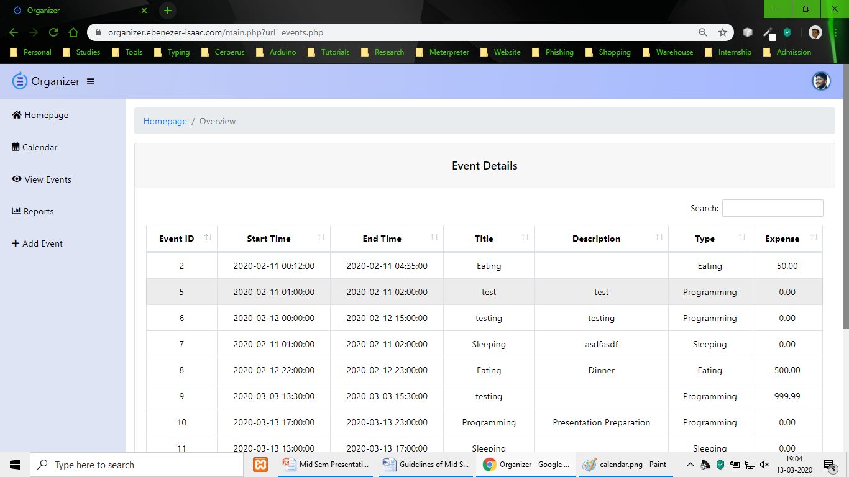

Slide 16
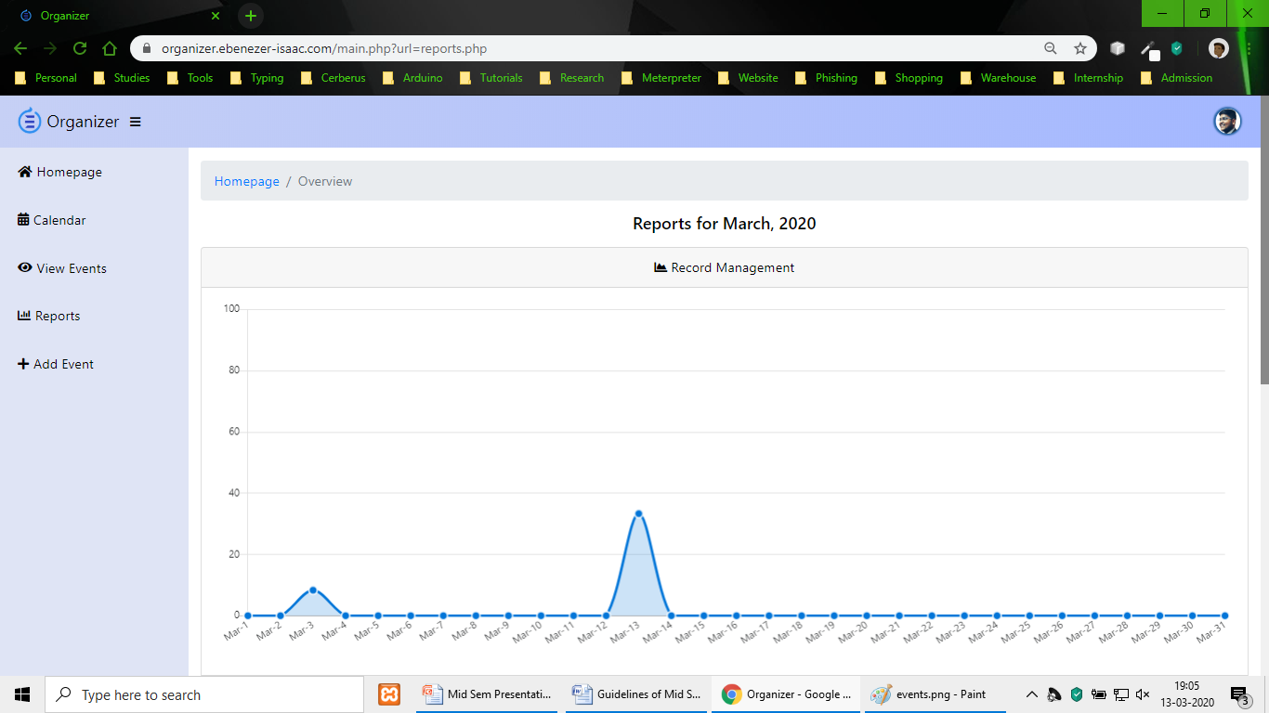

Slide 17
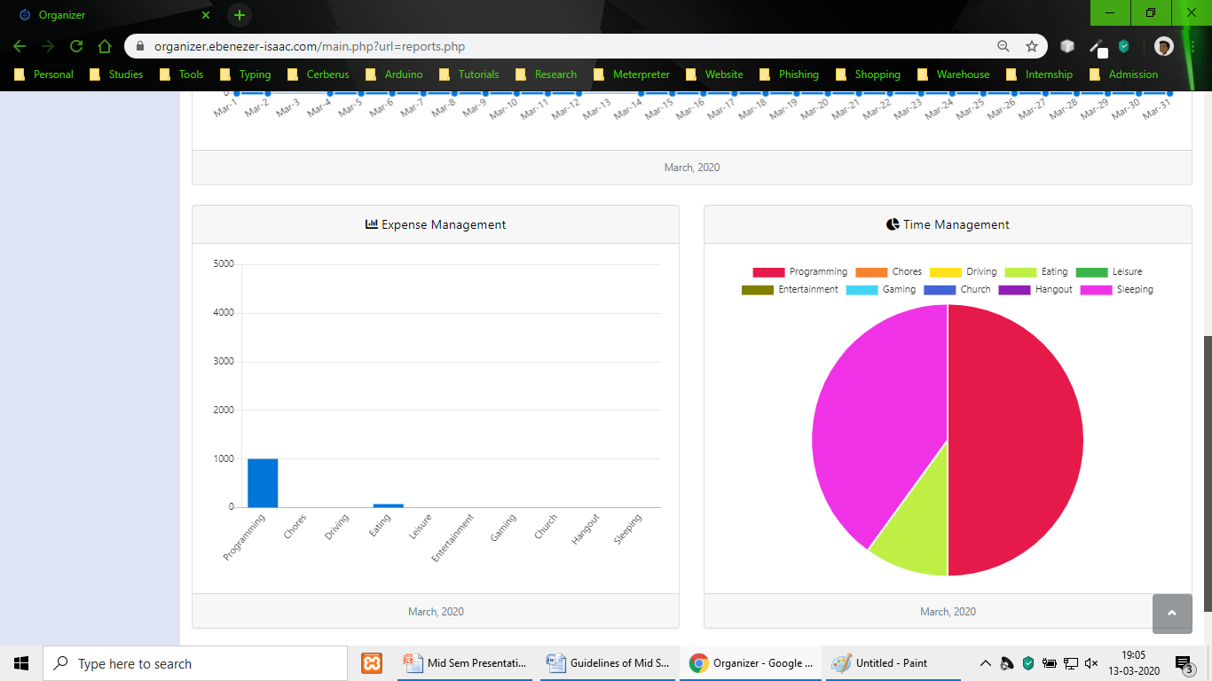

Slide 18


Slide 19
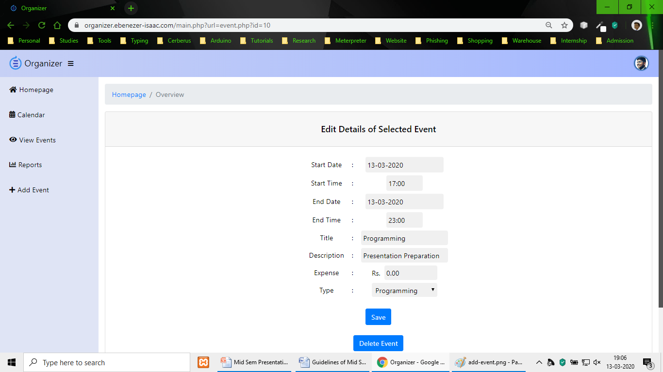

Slide 20


Slide 21
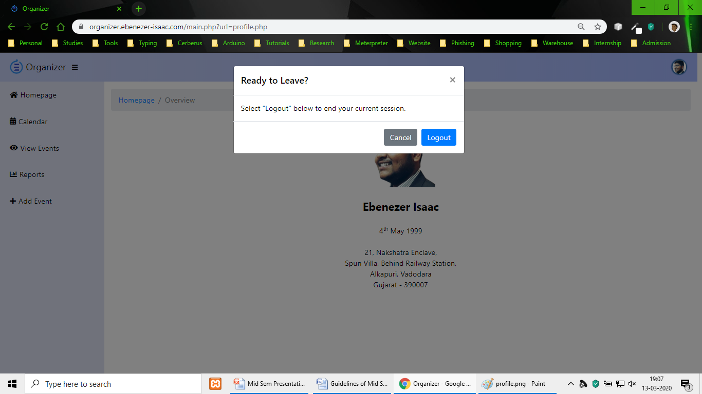

Slide 22
Intoxicated Face Identification
Work Completed
Accumulation
Modeling
Downloaded 150 videos from You Tube
1
4
Understanding factors defining the layers of neural network to build one
Extraction
Training
Extracted Faces from Video Stream
2
5
Need to train the neural network by providing the collected data
Preparation
Analysis
Removed misidentified faces and resized them equally
Final Size: 60,250 Images
3
6
Prepare a report on the accuracy of the neural network model created

Slide 23


Slide 24


Slide 25
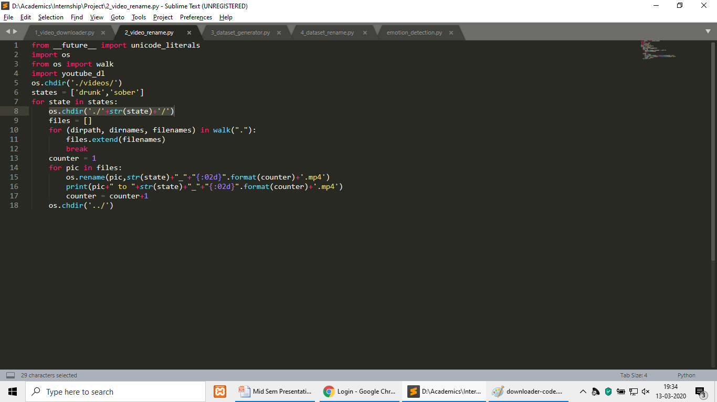

Slide 26


Slide 27
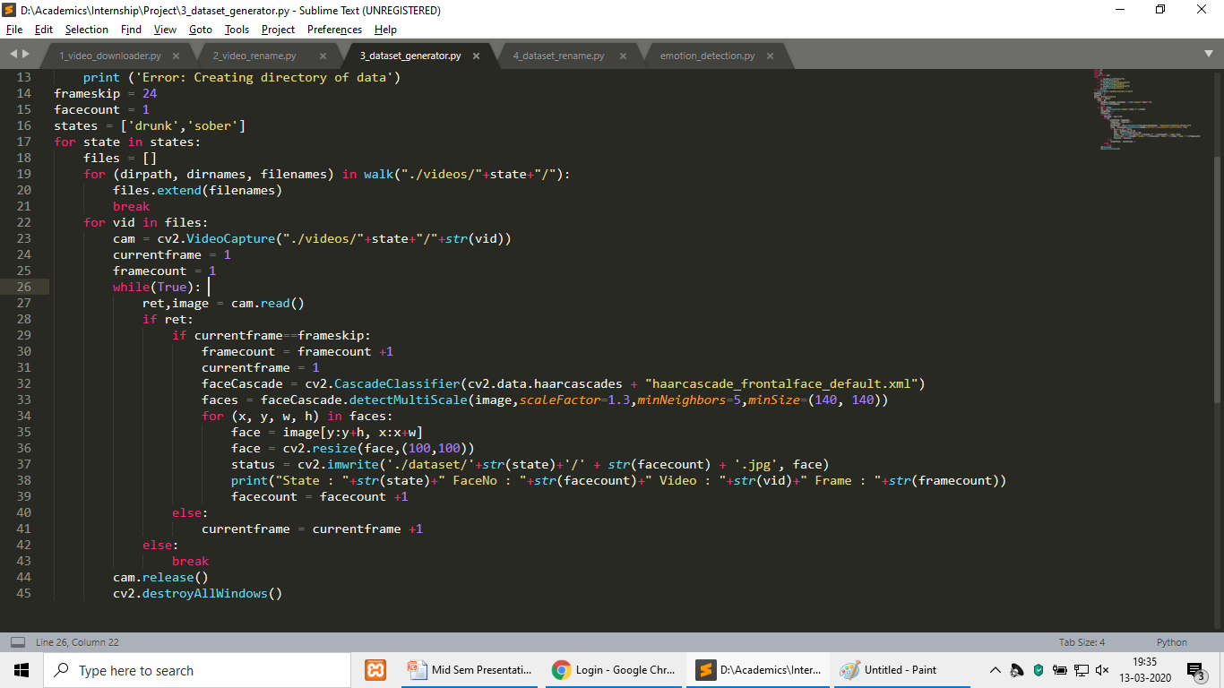

Slide 28
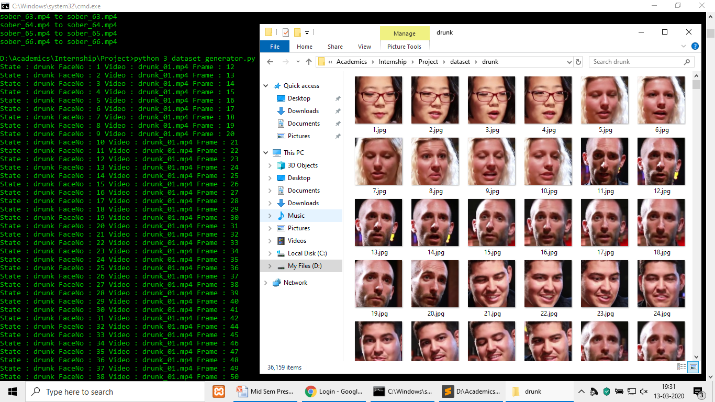

Slide 29
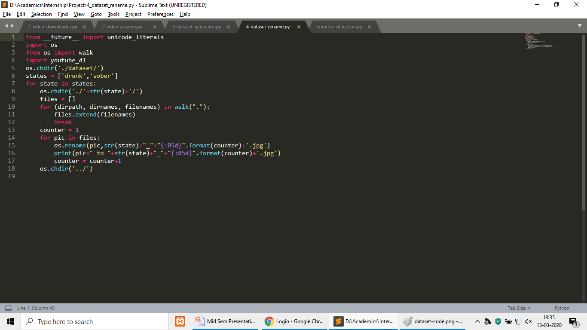

Slide 30
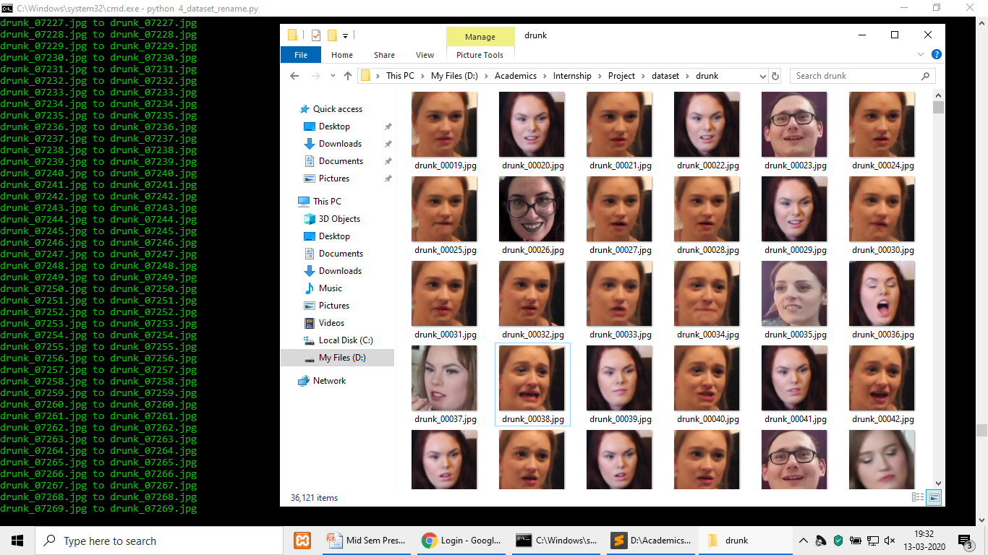

Slide 31


